Slide 1
Multiplication table of Td
Useful for defining a particular order of elements in Td

Slide 2
Multiplication table for Td by coordinate transformations

Slide 3
Multiplication table for Td by operator index

Slide 4
Effect of Td operations on solid angle coordinates

Slide 5

Products of representations expressed as sums of representations

Slide 6
Our REPRESENTATION OF TD
A set of specific irreducible matrix representations of elements in Td

Slide 7
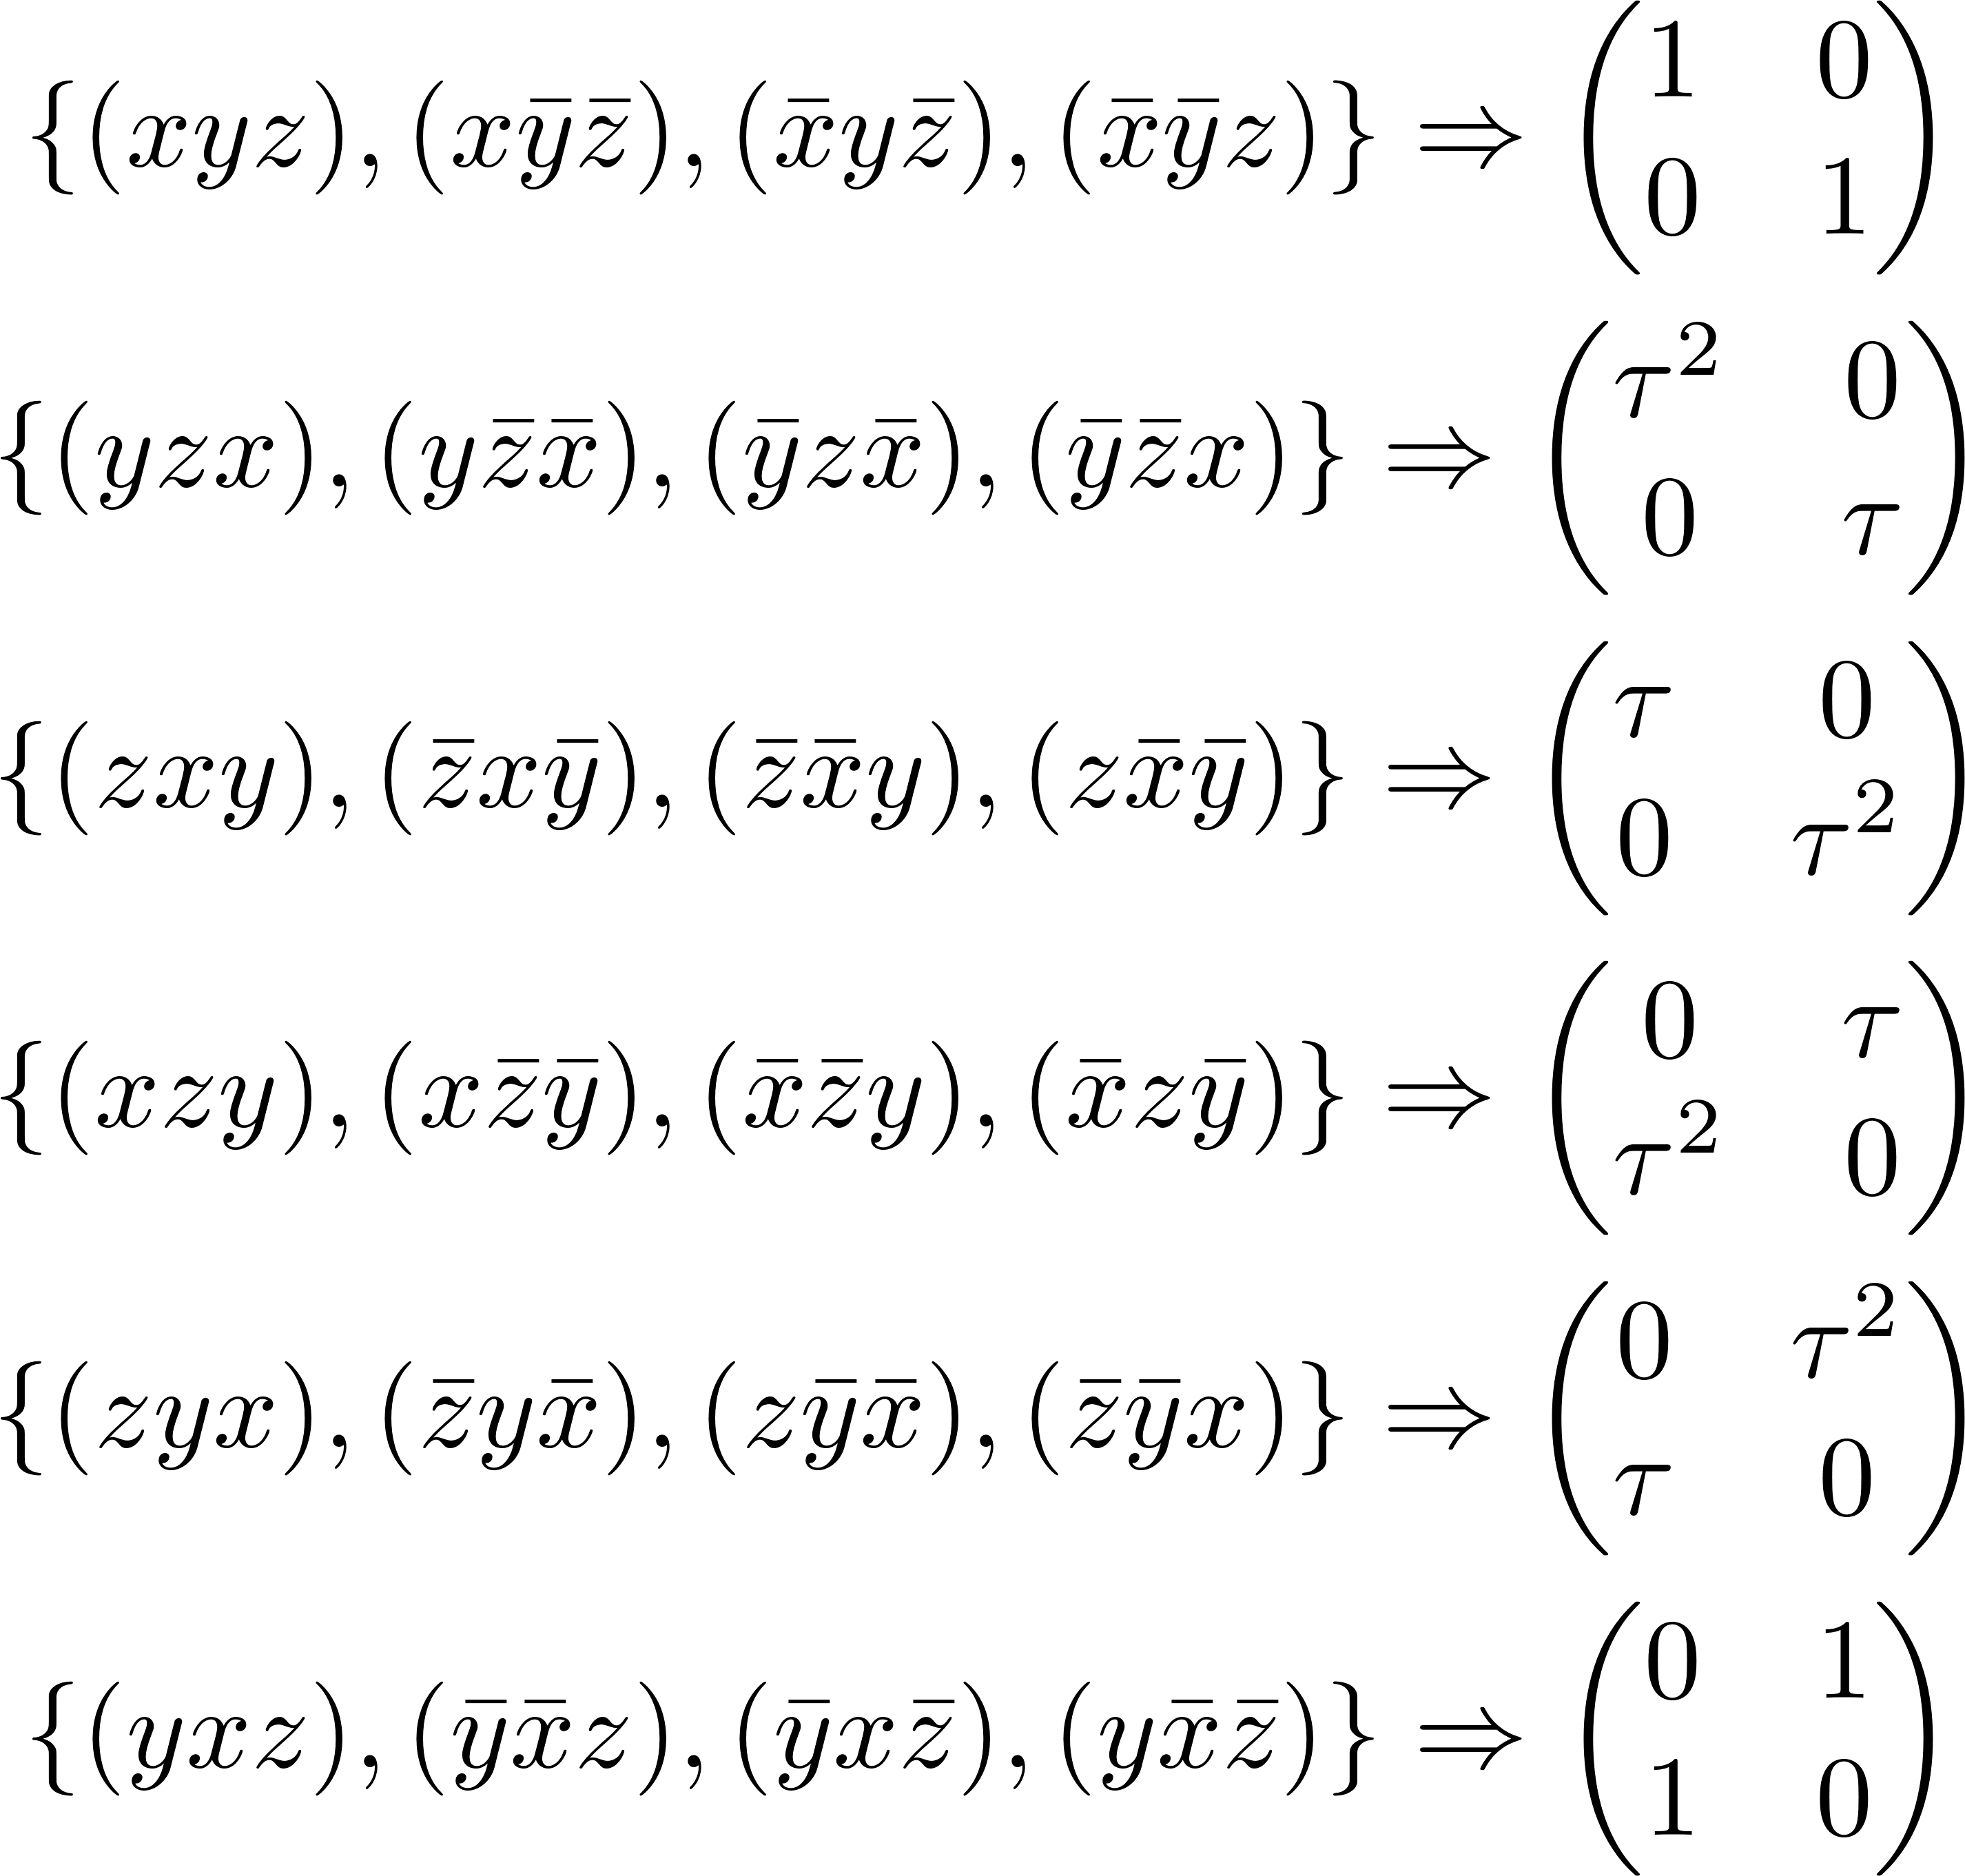
Matrix representation of T_{d} – A₁, A₂, and E

Slide 8
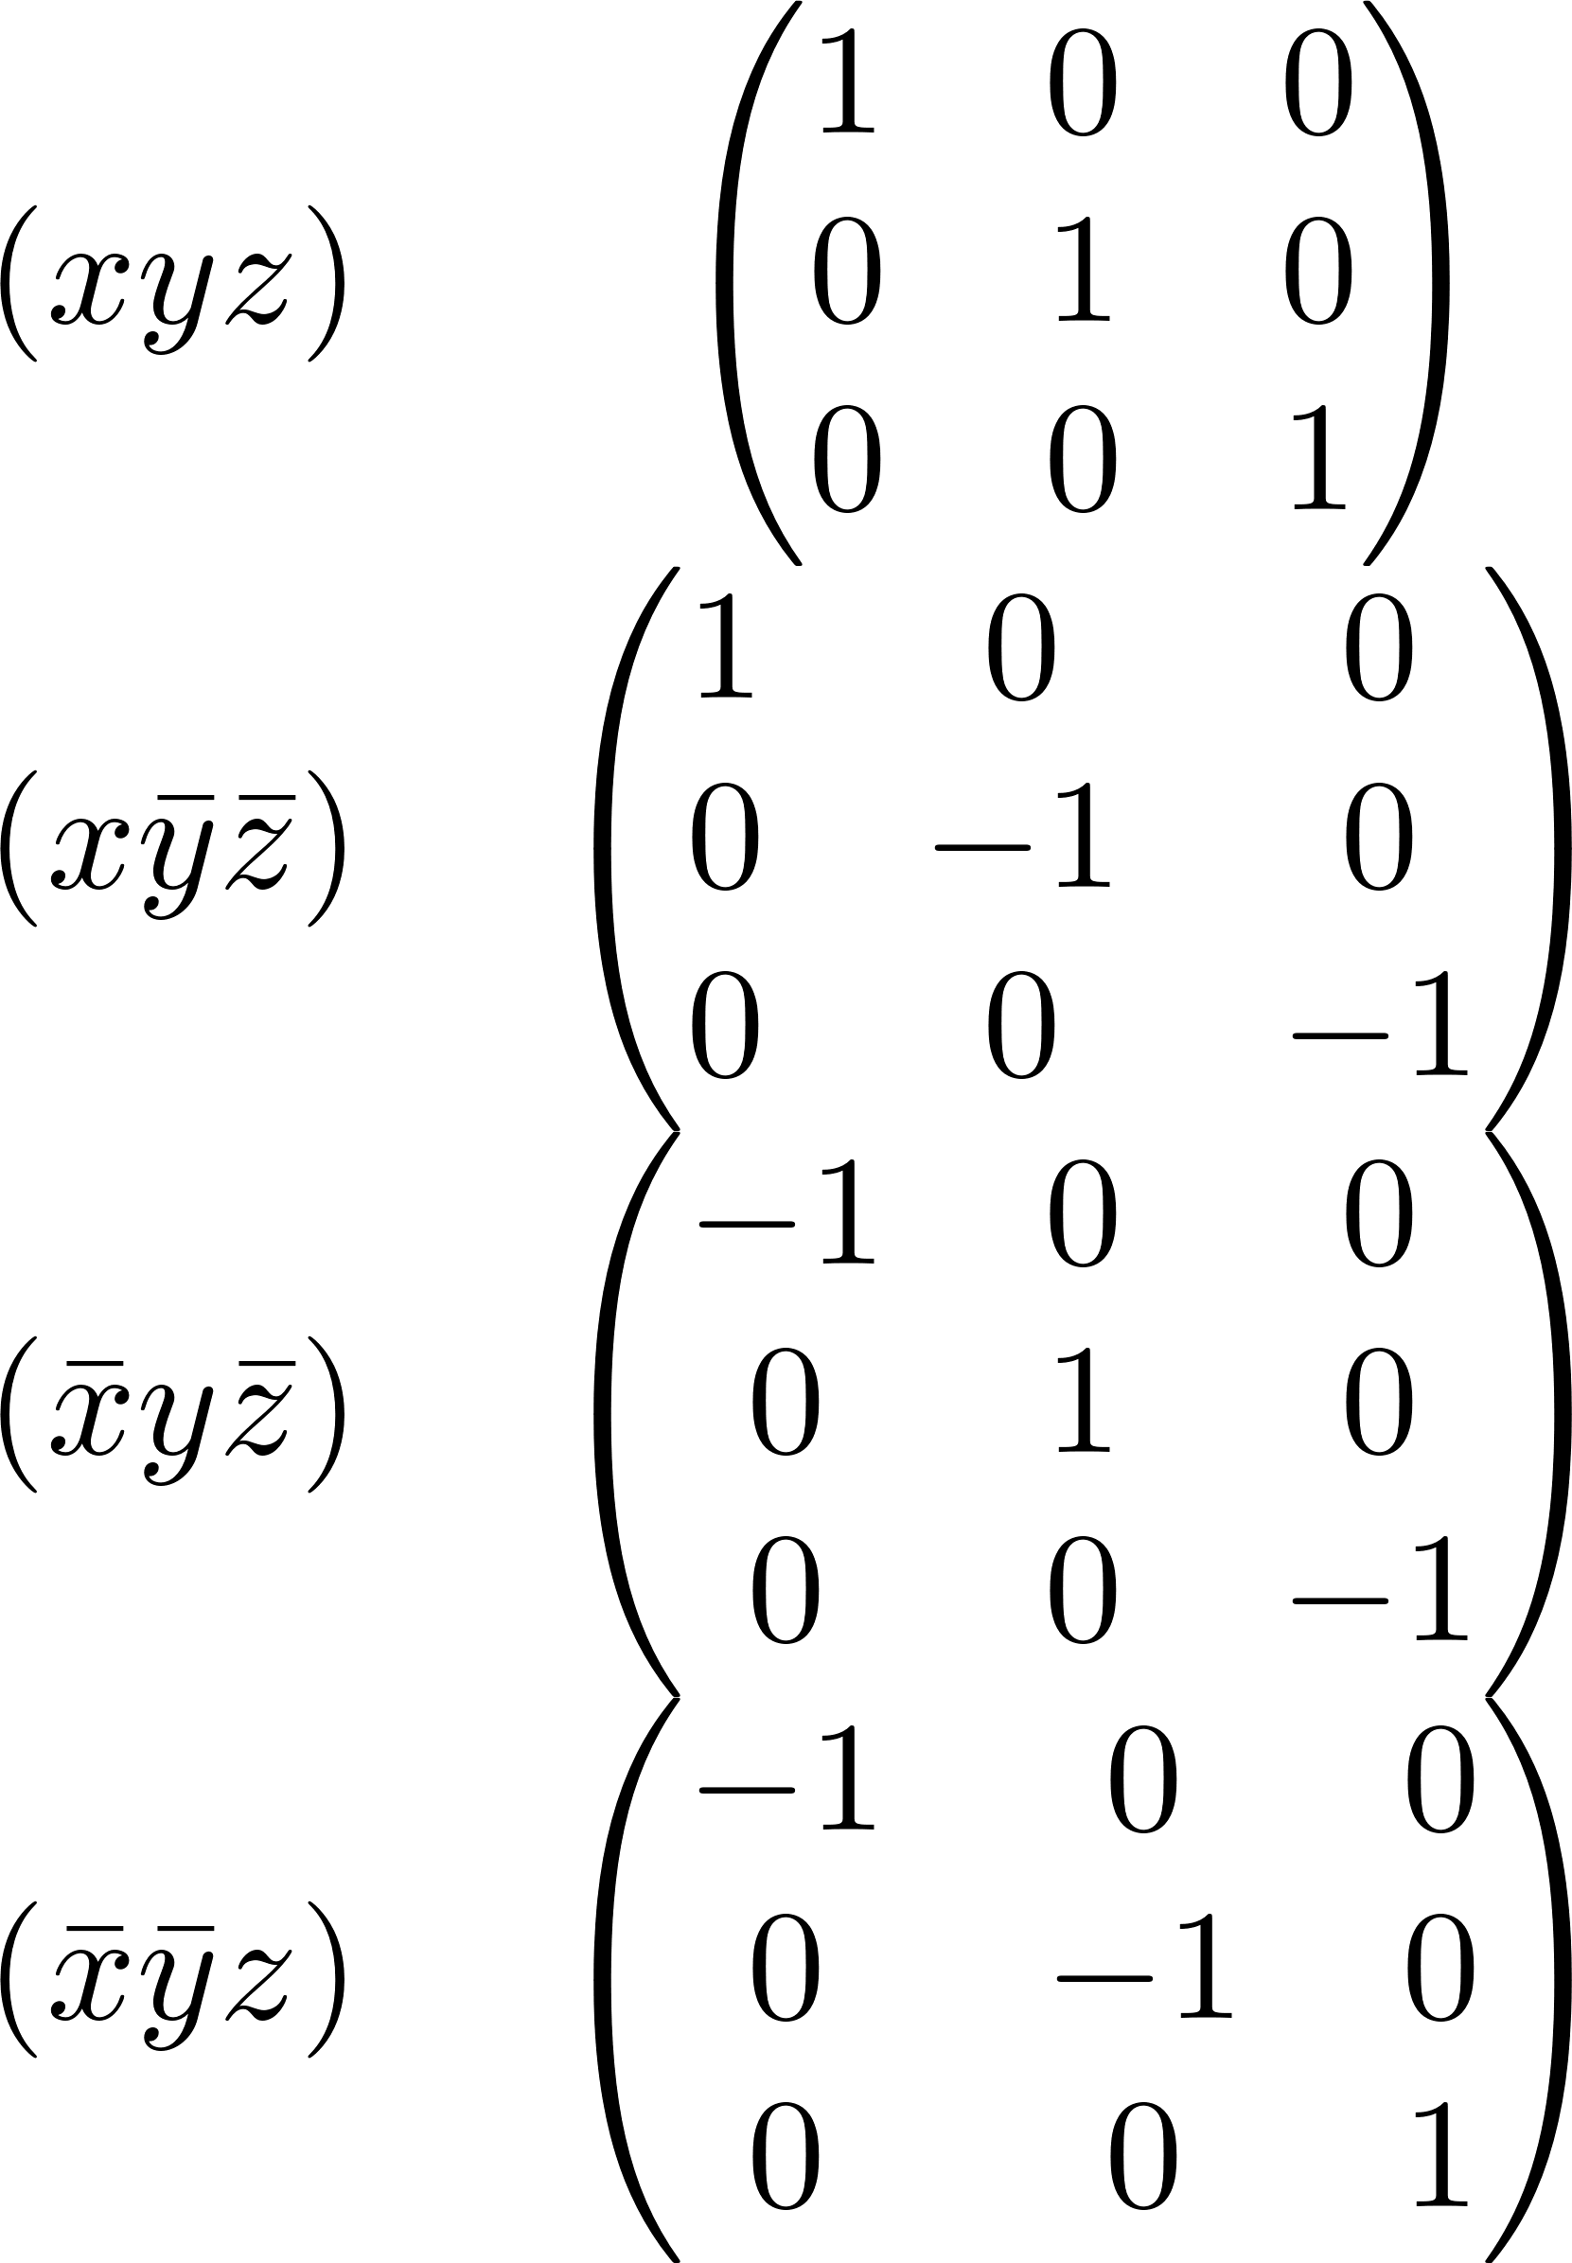
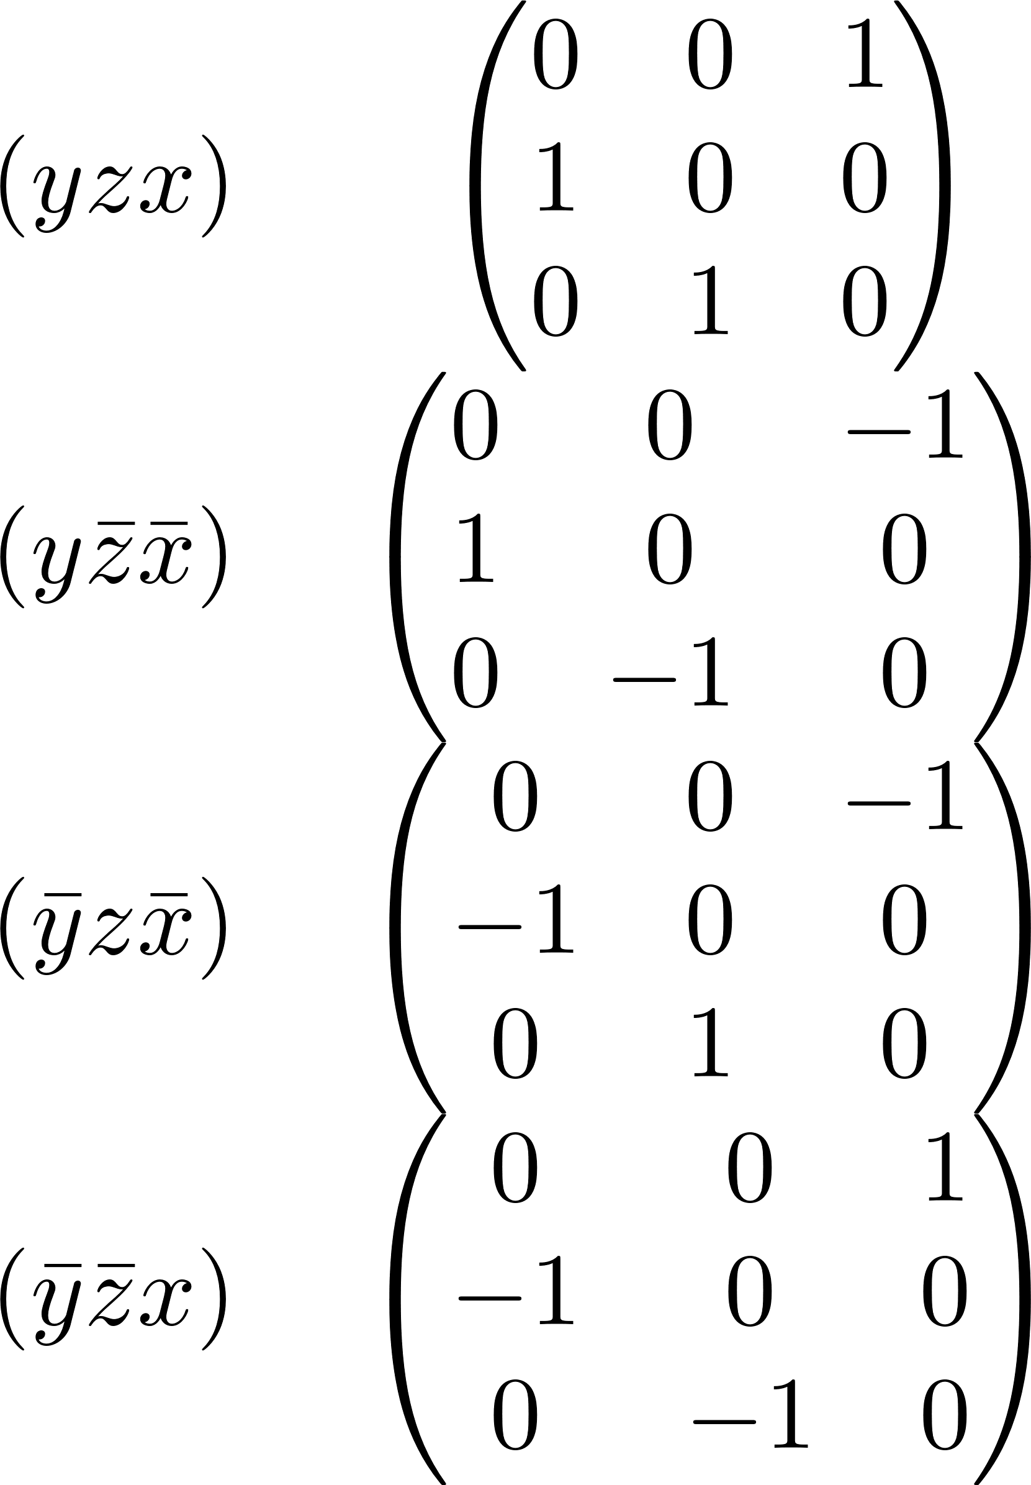
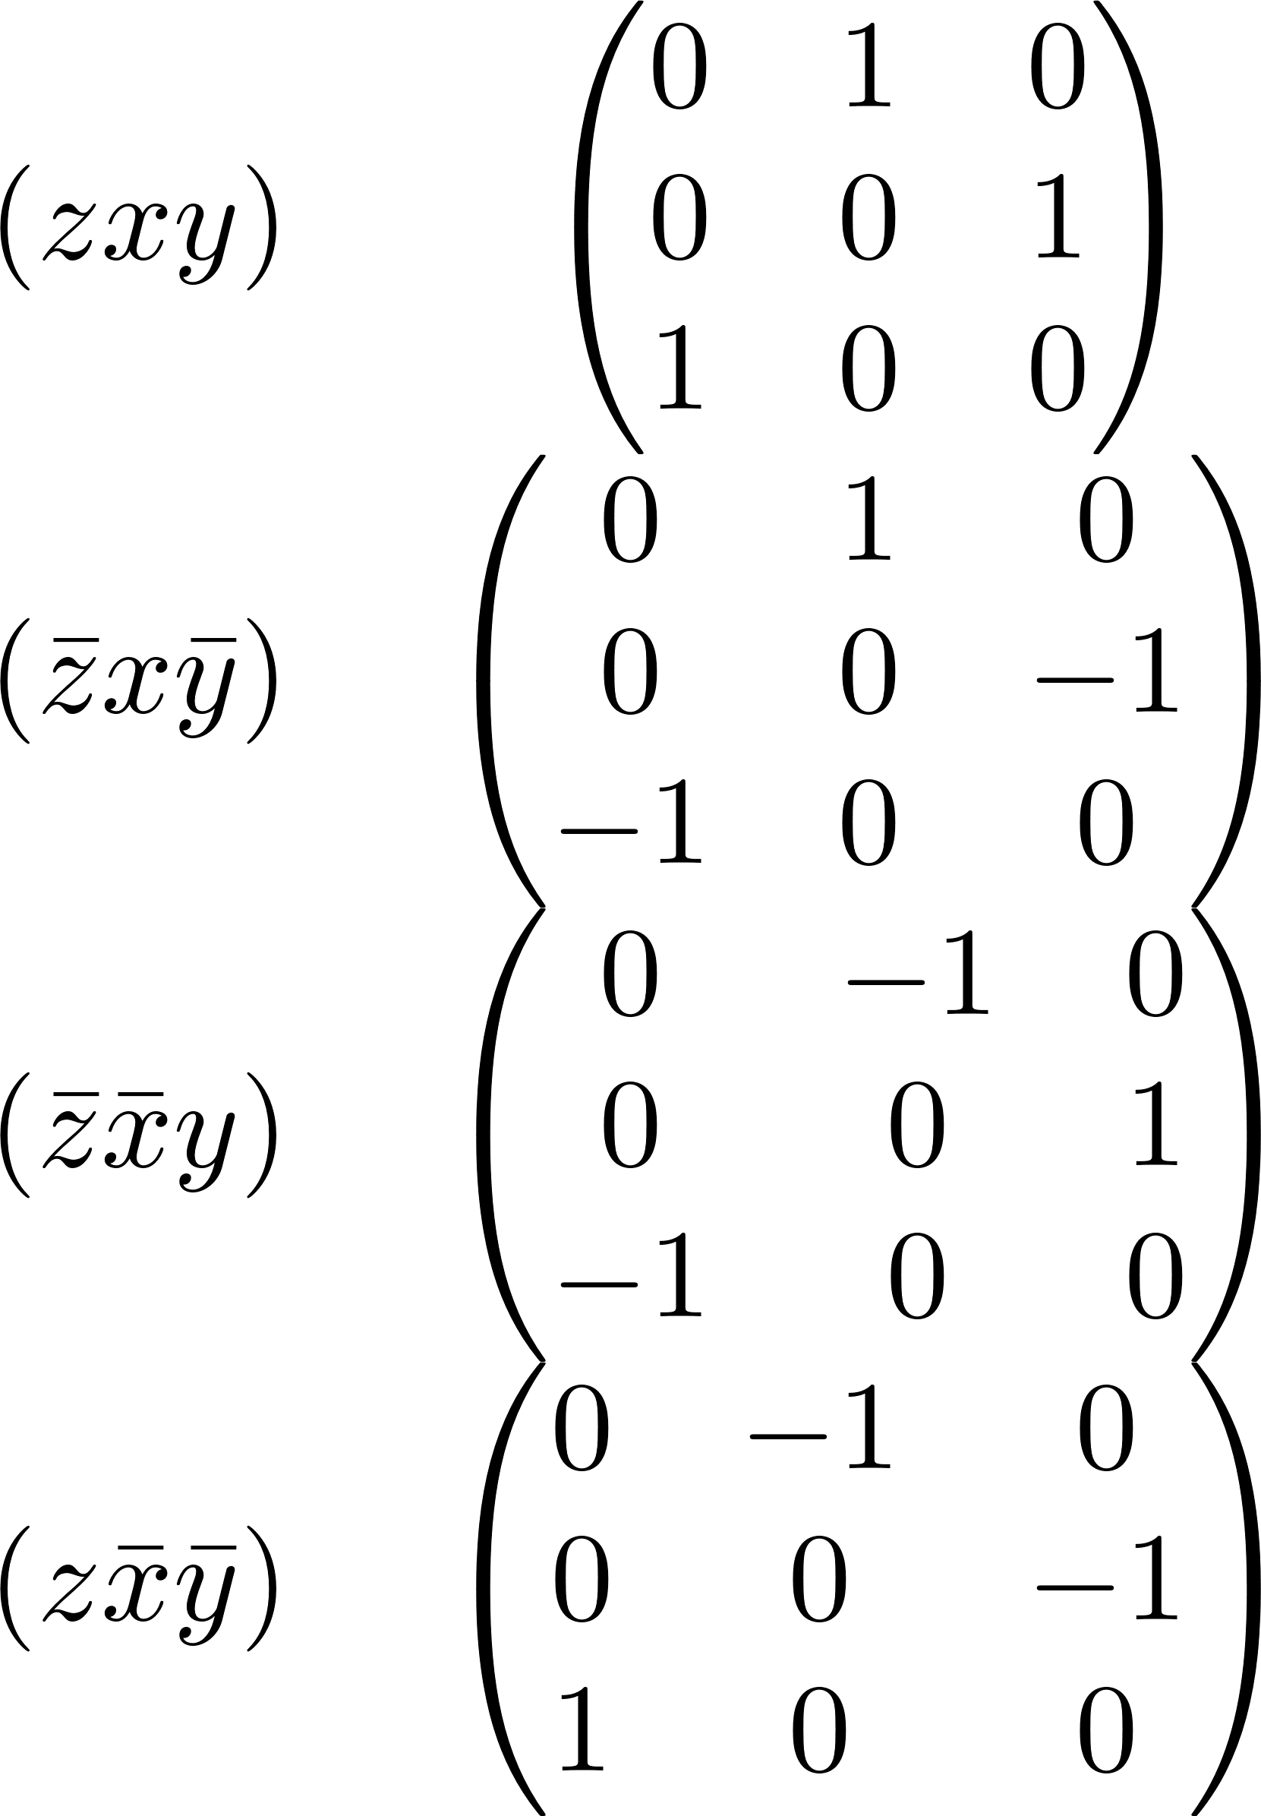
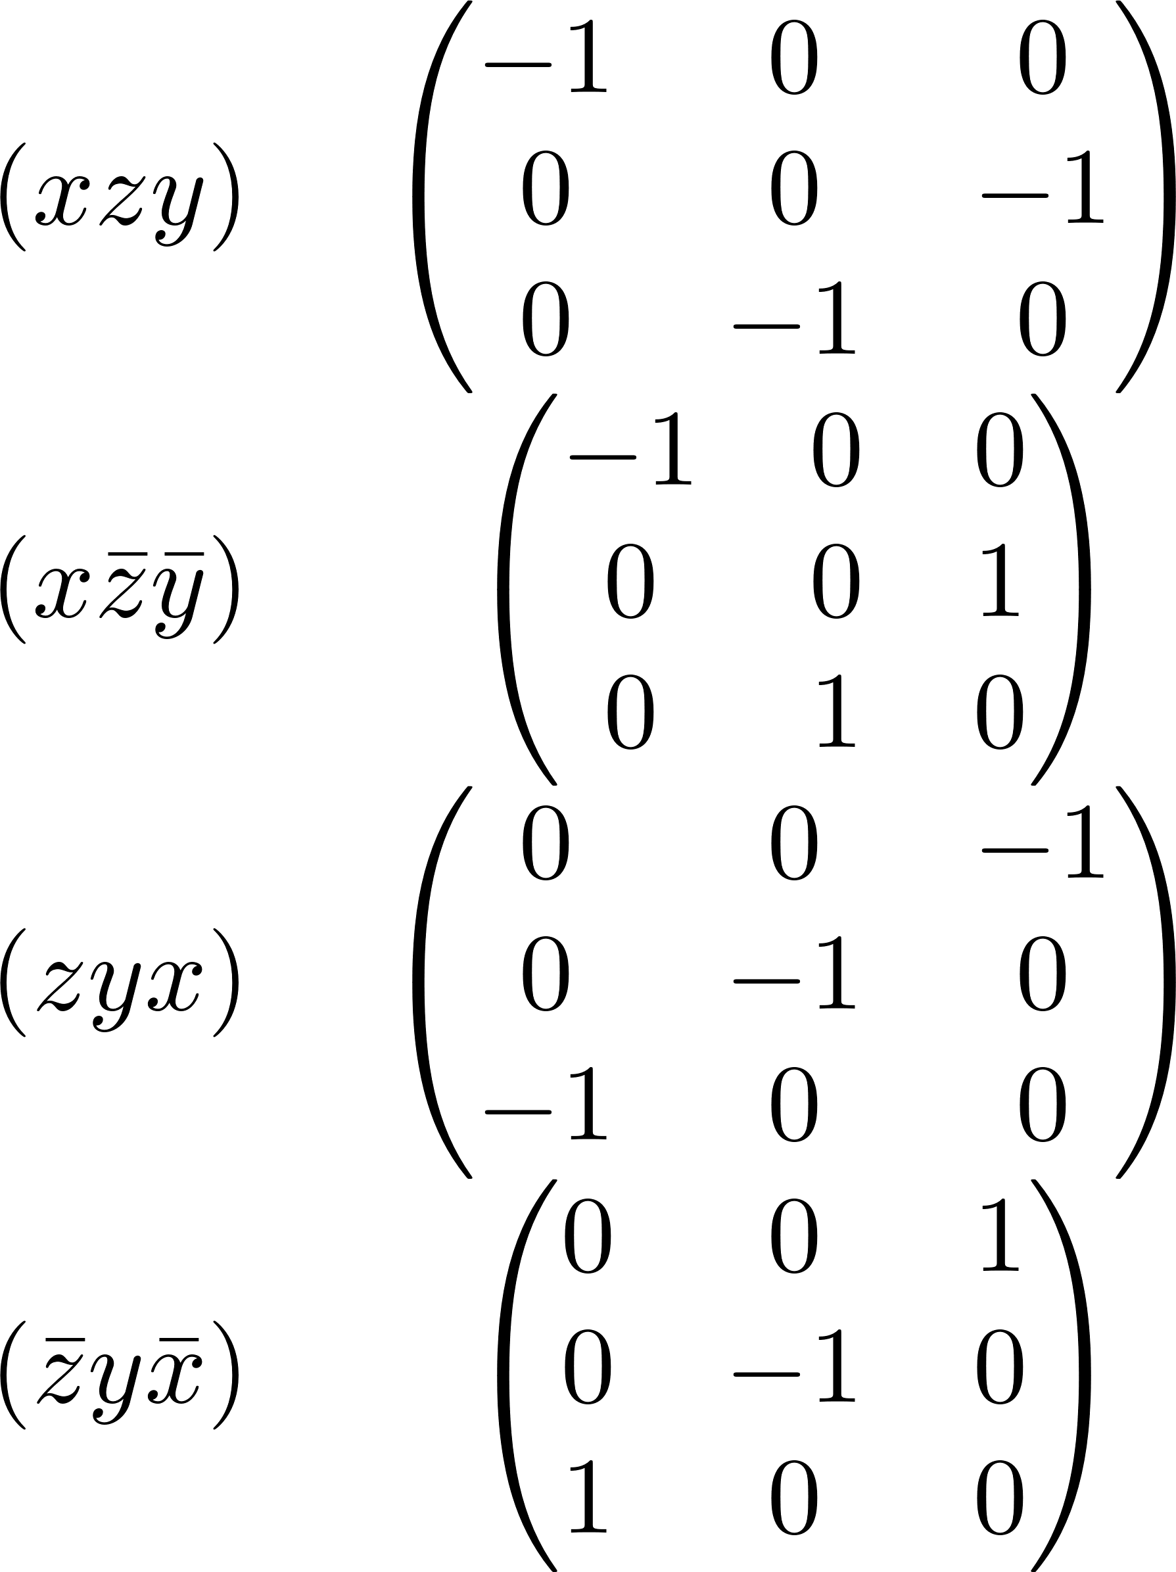
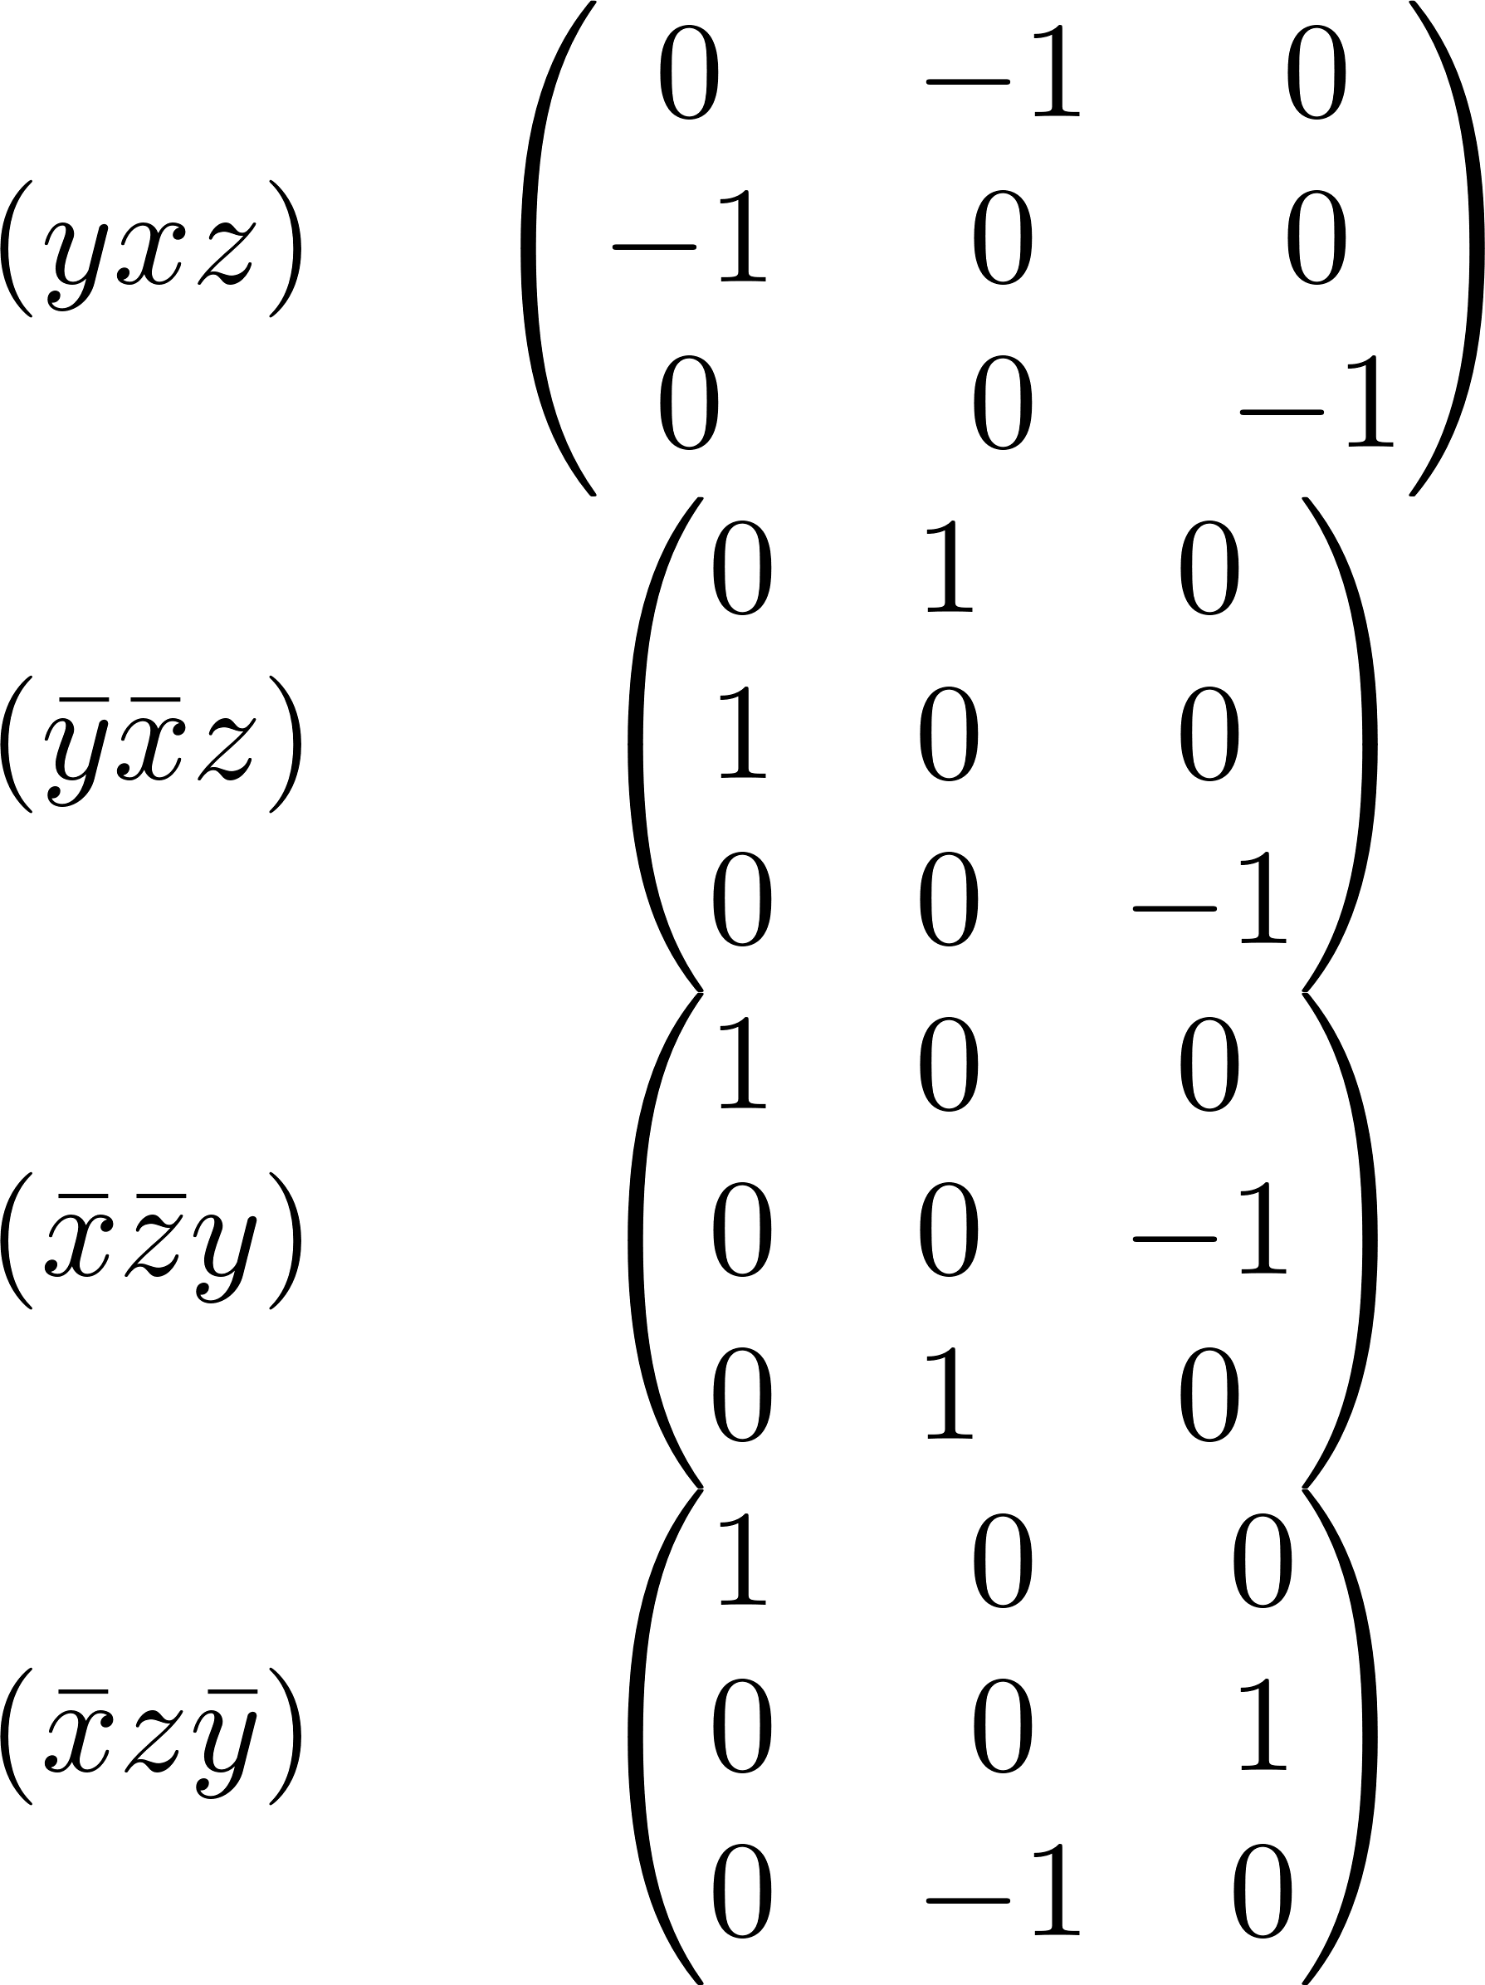
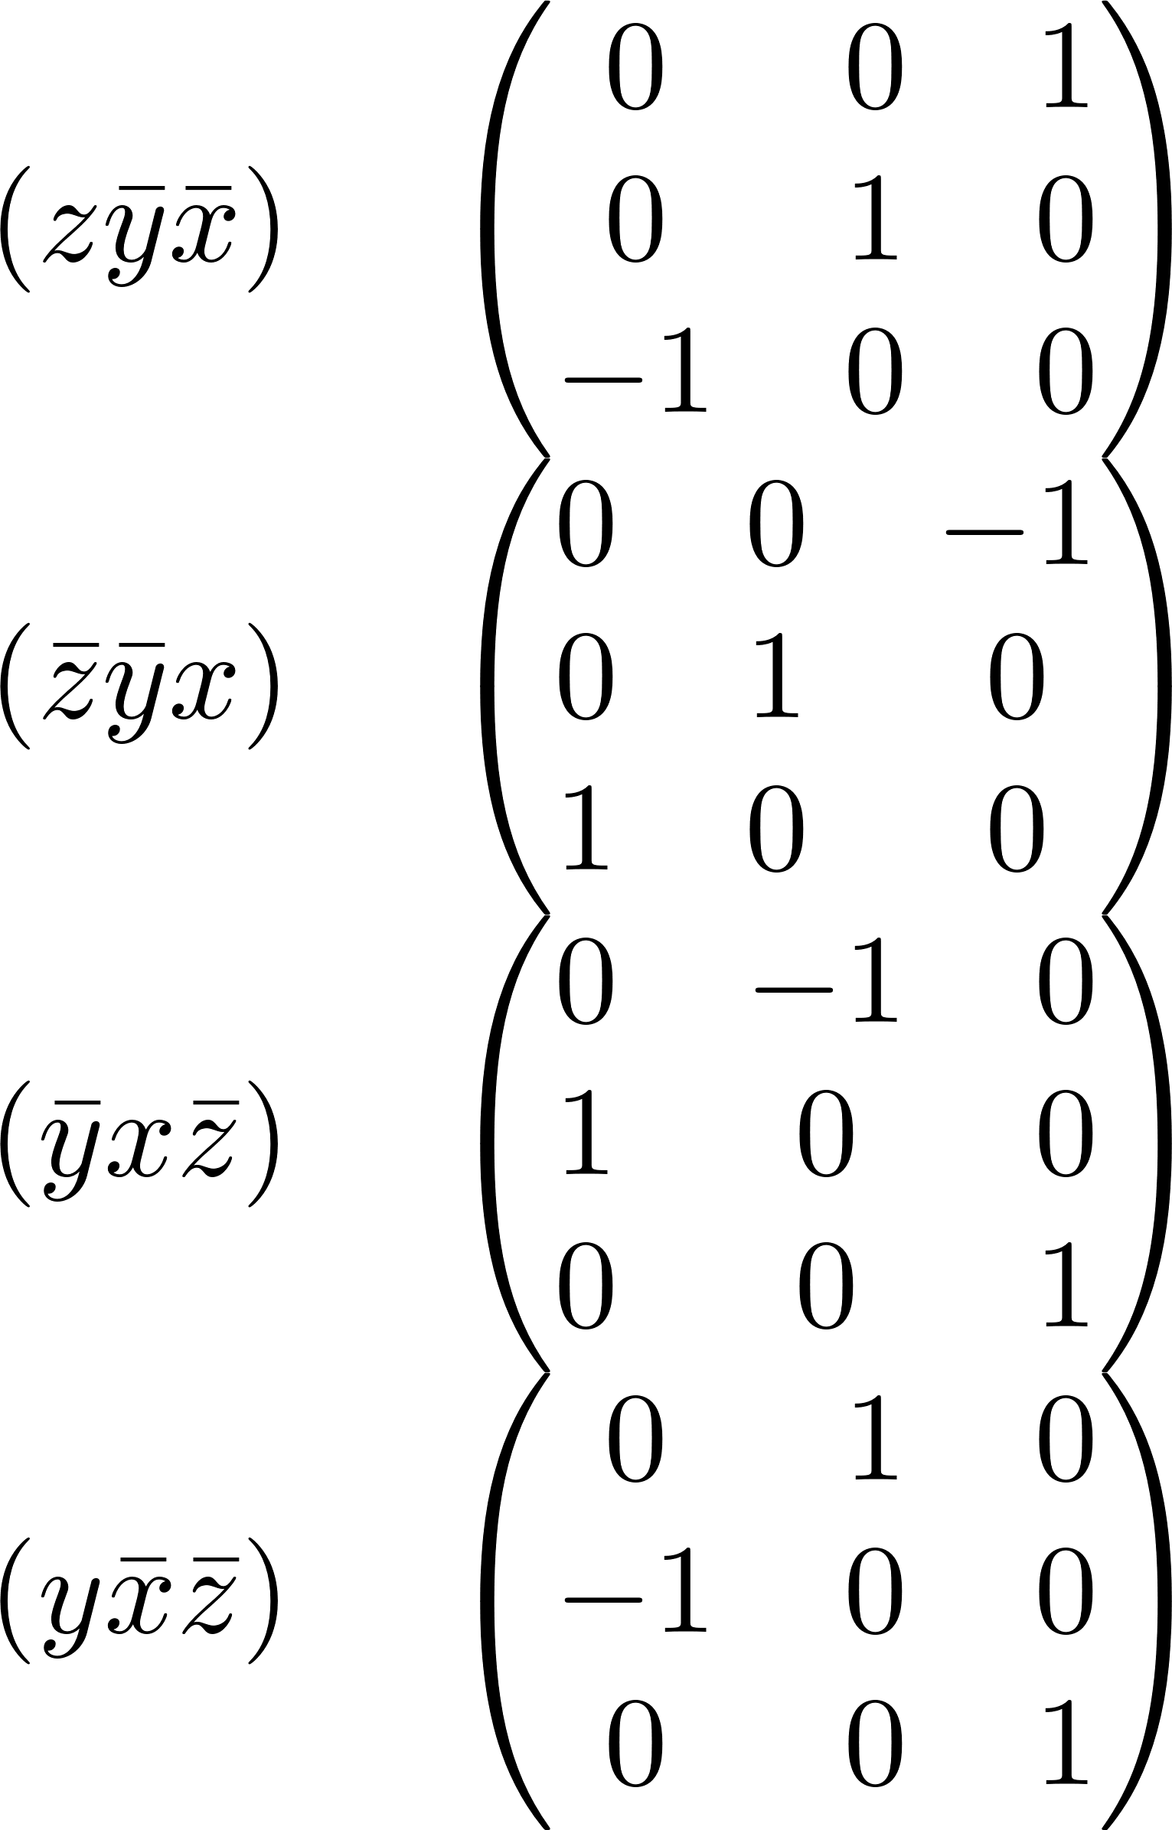
Matrix representation of T_{d} – T₁

Slide 9
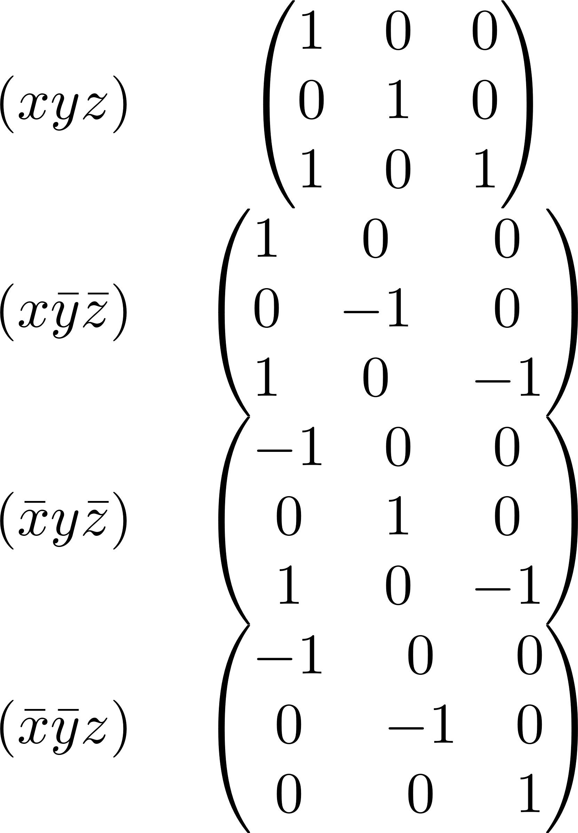
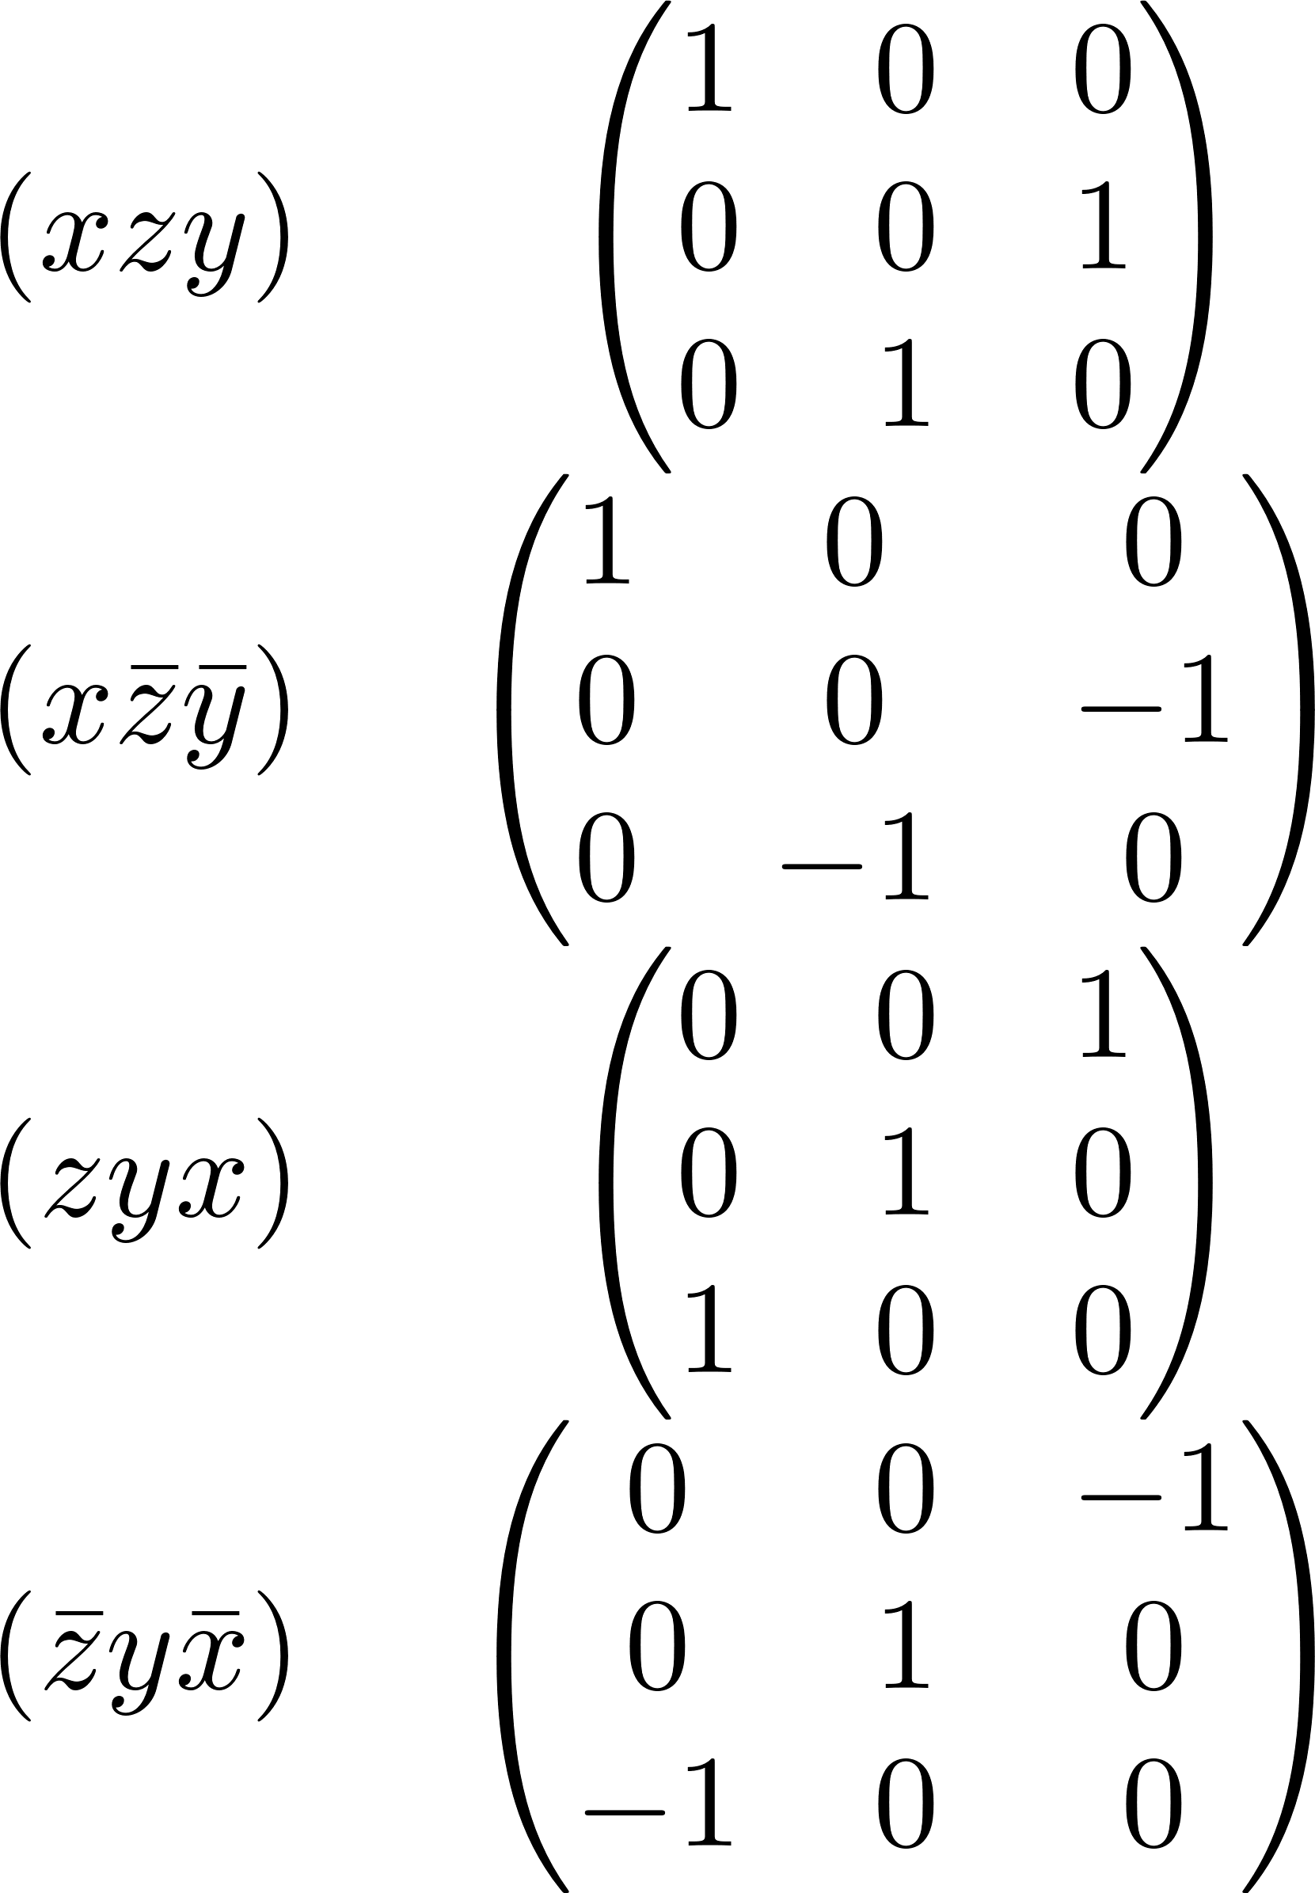
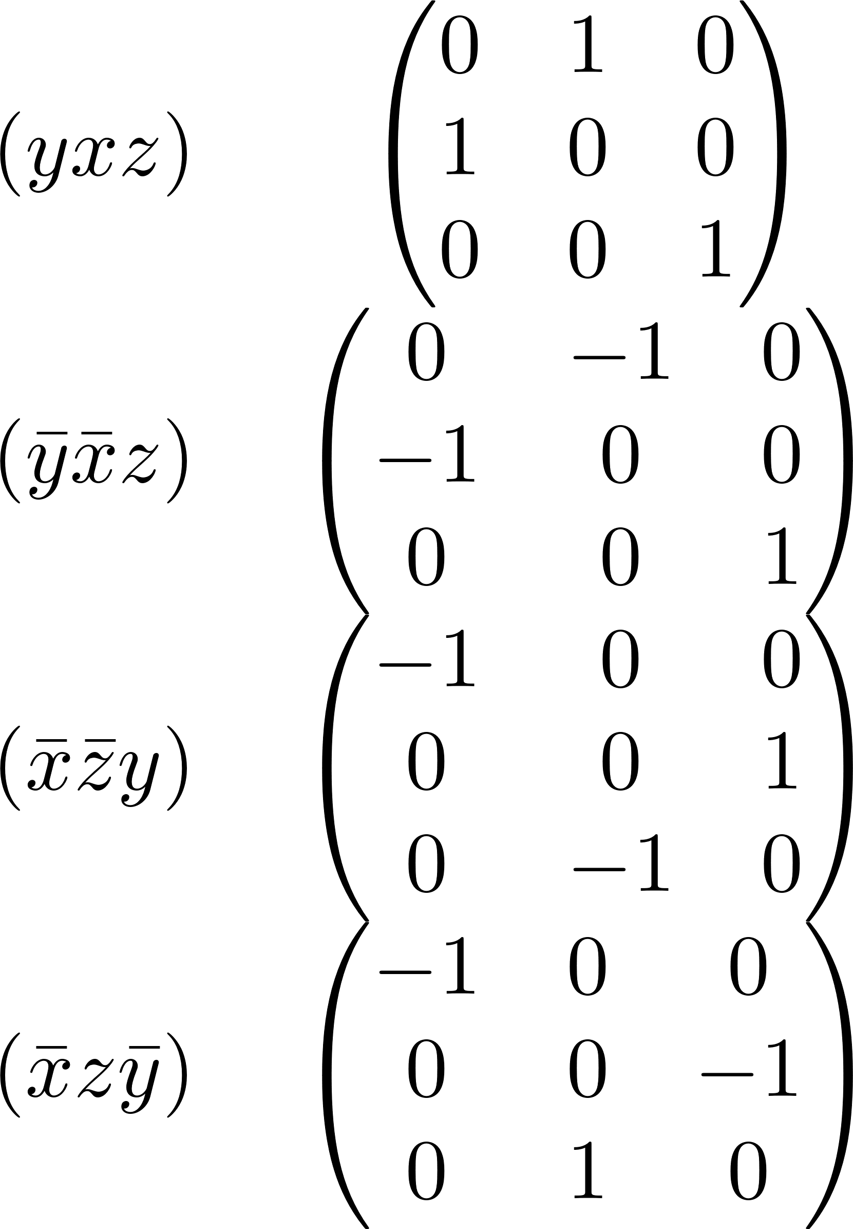
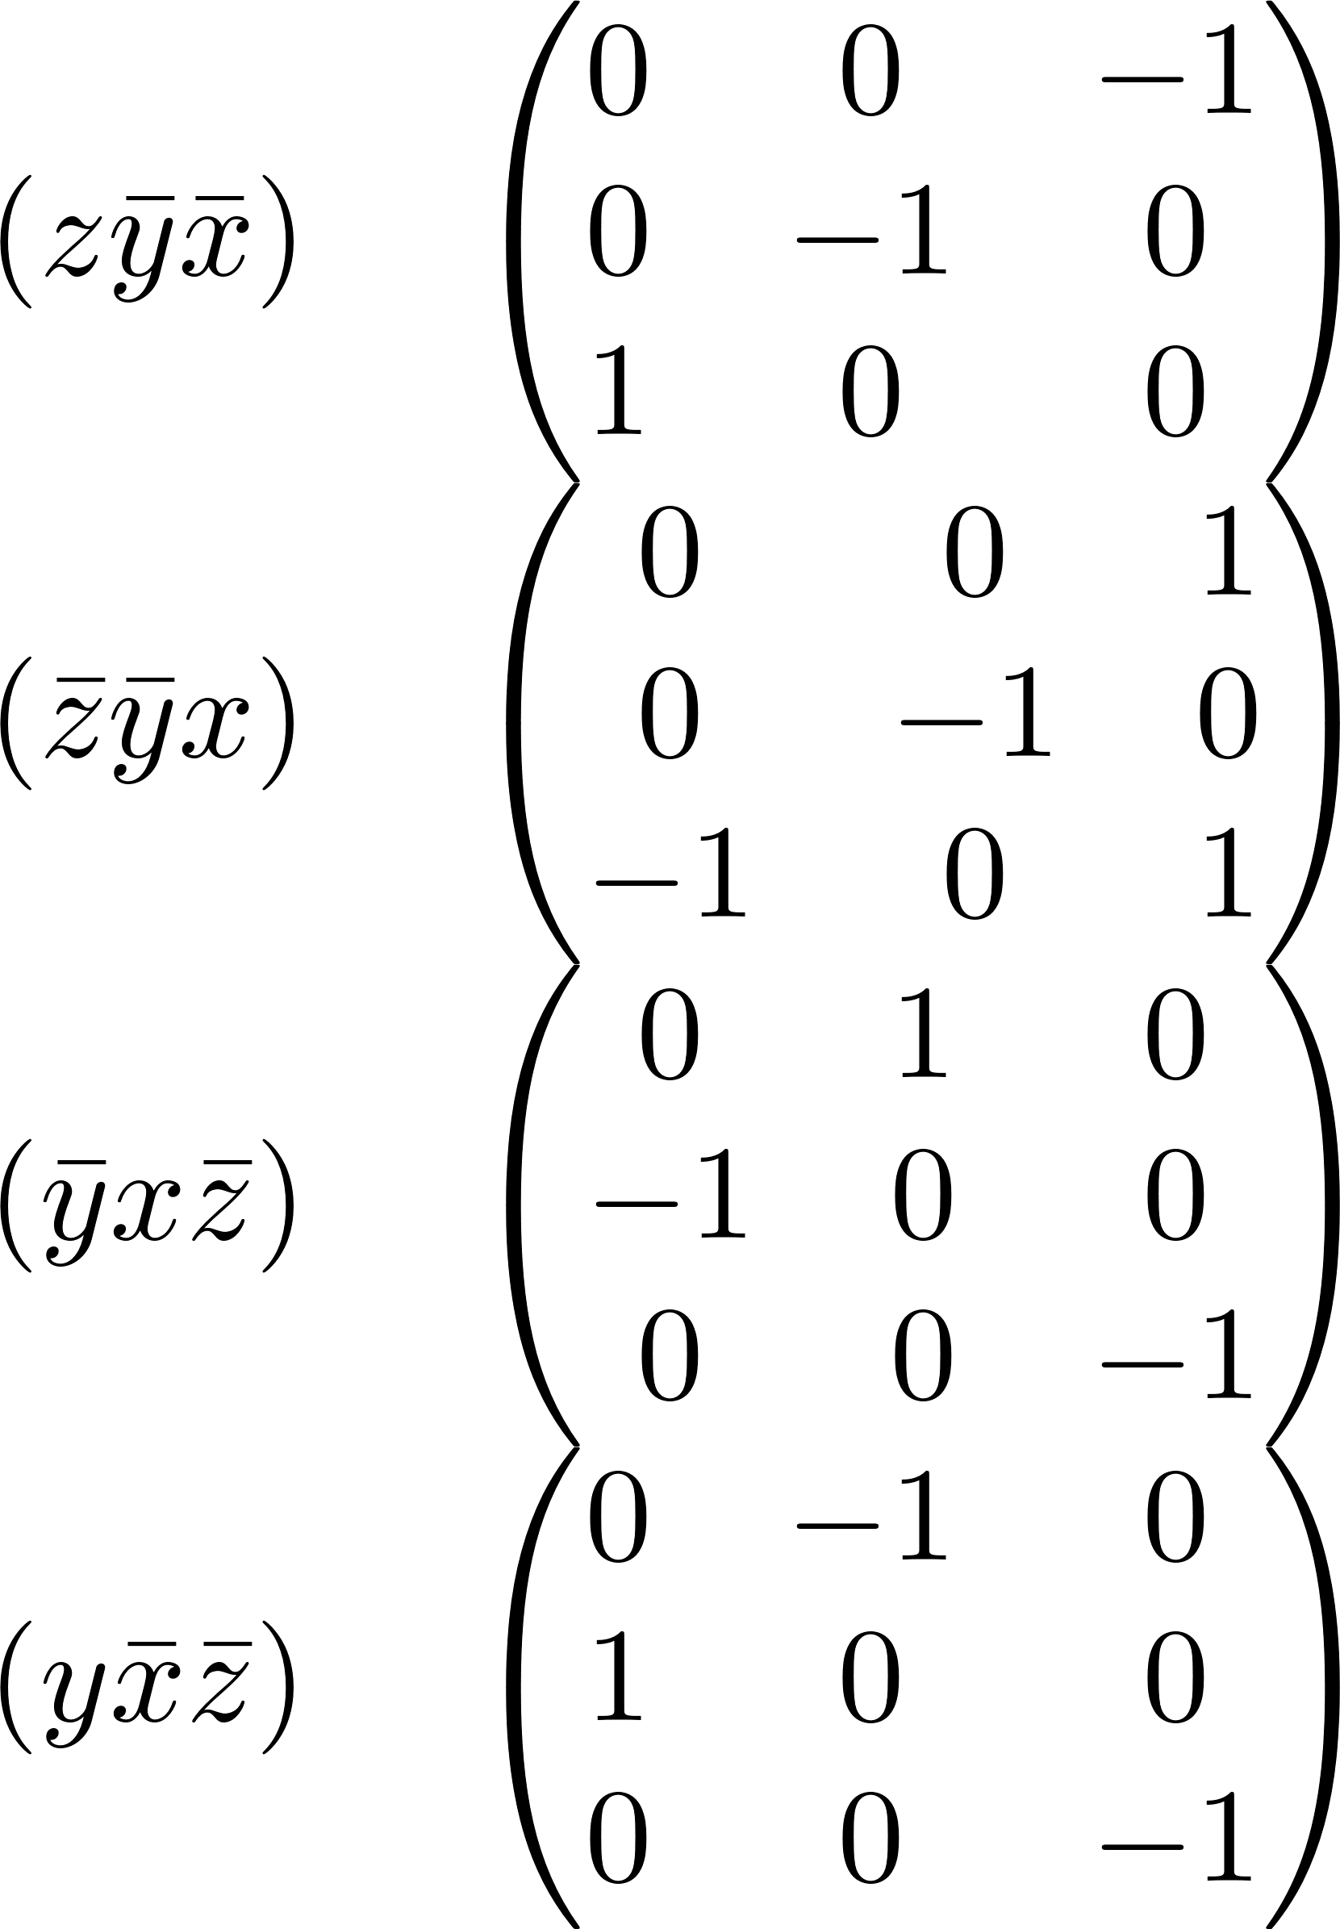
Matrix representation of T_{d} – T₂

Slide 10
GROUP THEORY
Resolving a function in terms of the irreducible representations of Td

Slide 11
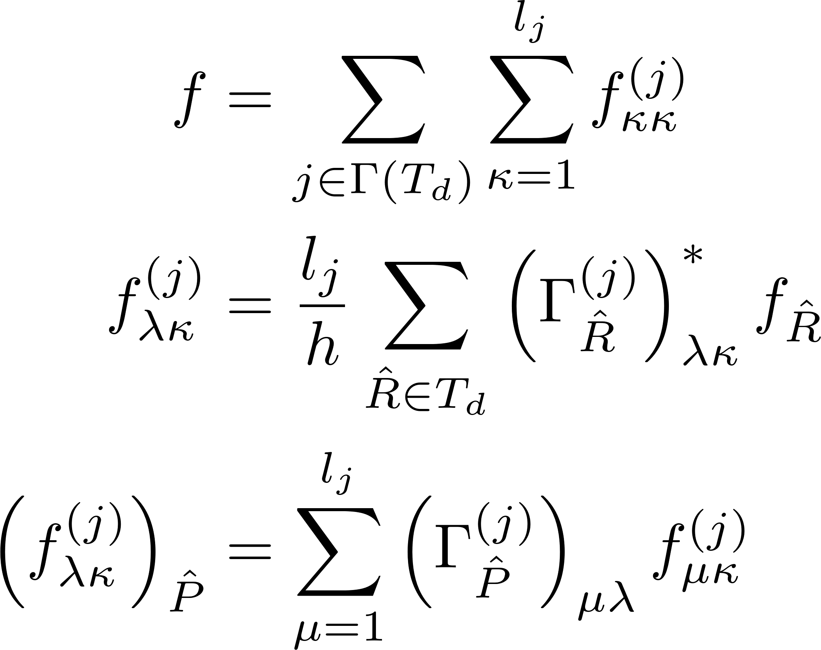
Function projected onto symmetries of Td

Slide 12





Symmetrized potential – A₁, A₂, and E

Slide 13






Symmetrized potential – T₁ and T₂

Slide 14


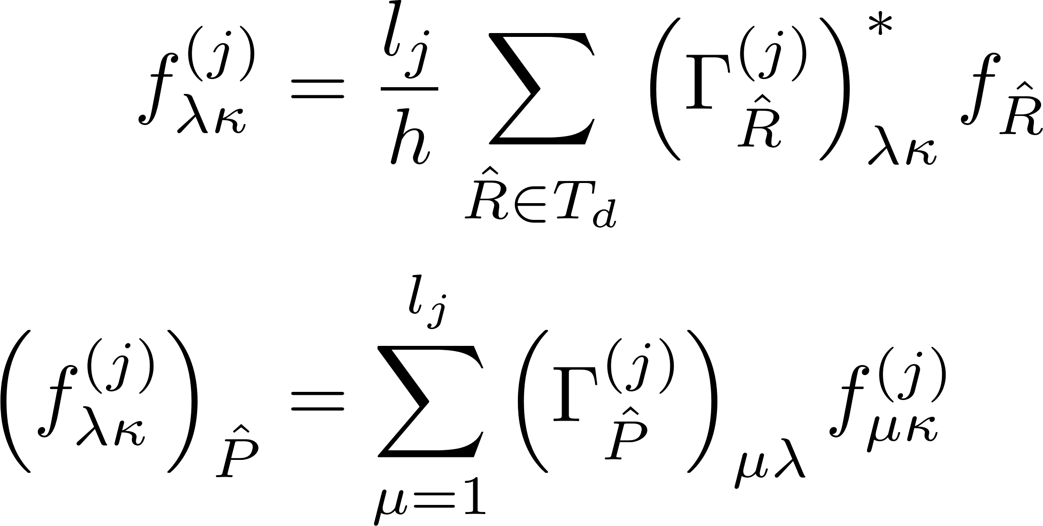
Transformation of symmetrized potential – E

Slide 15






Transformation of symmetrized potential – T₁

Slide 16






Transformation of symmetrized potential – T₂

Slide 17
GROUP OPERATIONS
Resolving the effect of our operator representations onto the resolved parts of a function corresponding to each irreducible representation of Td

Slide 18
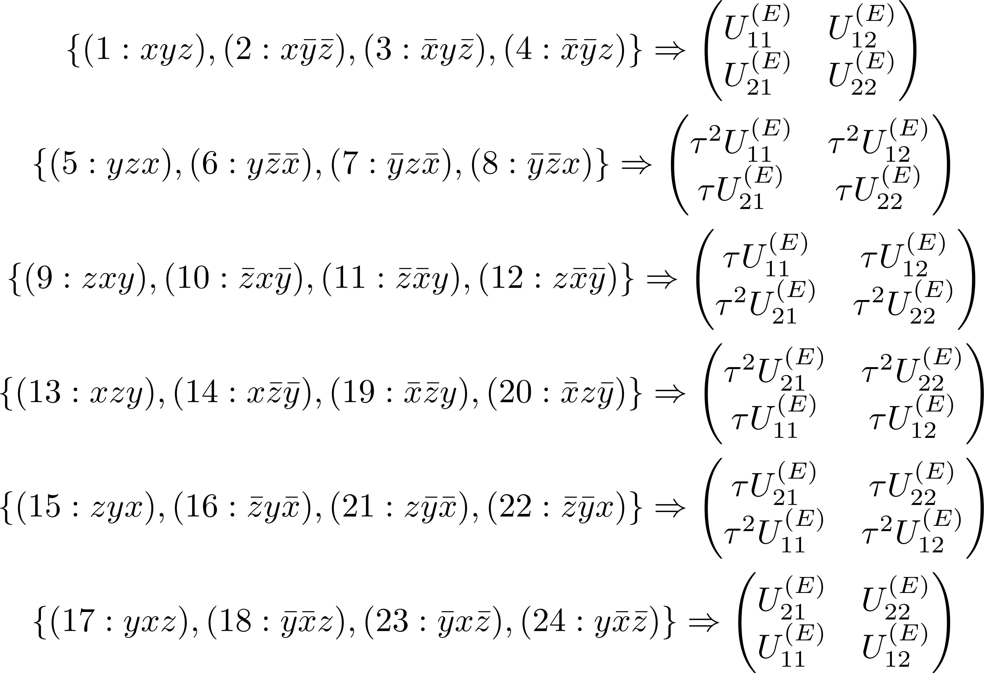
Matrix representation of T_{d} – A^{(σ)}, and E

Slide 19
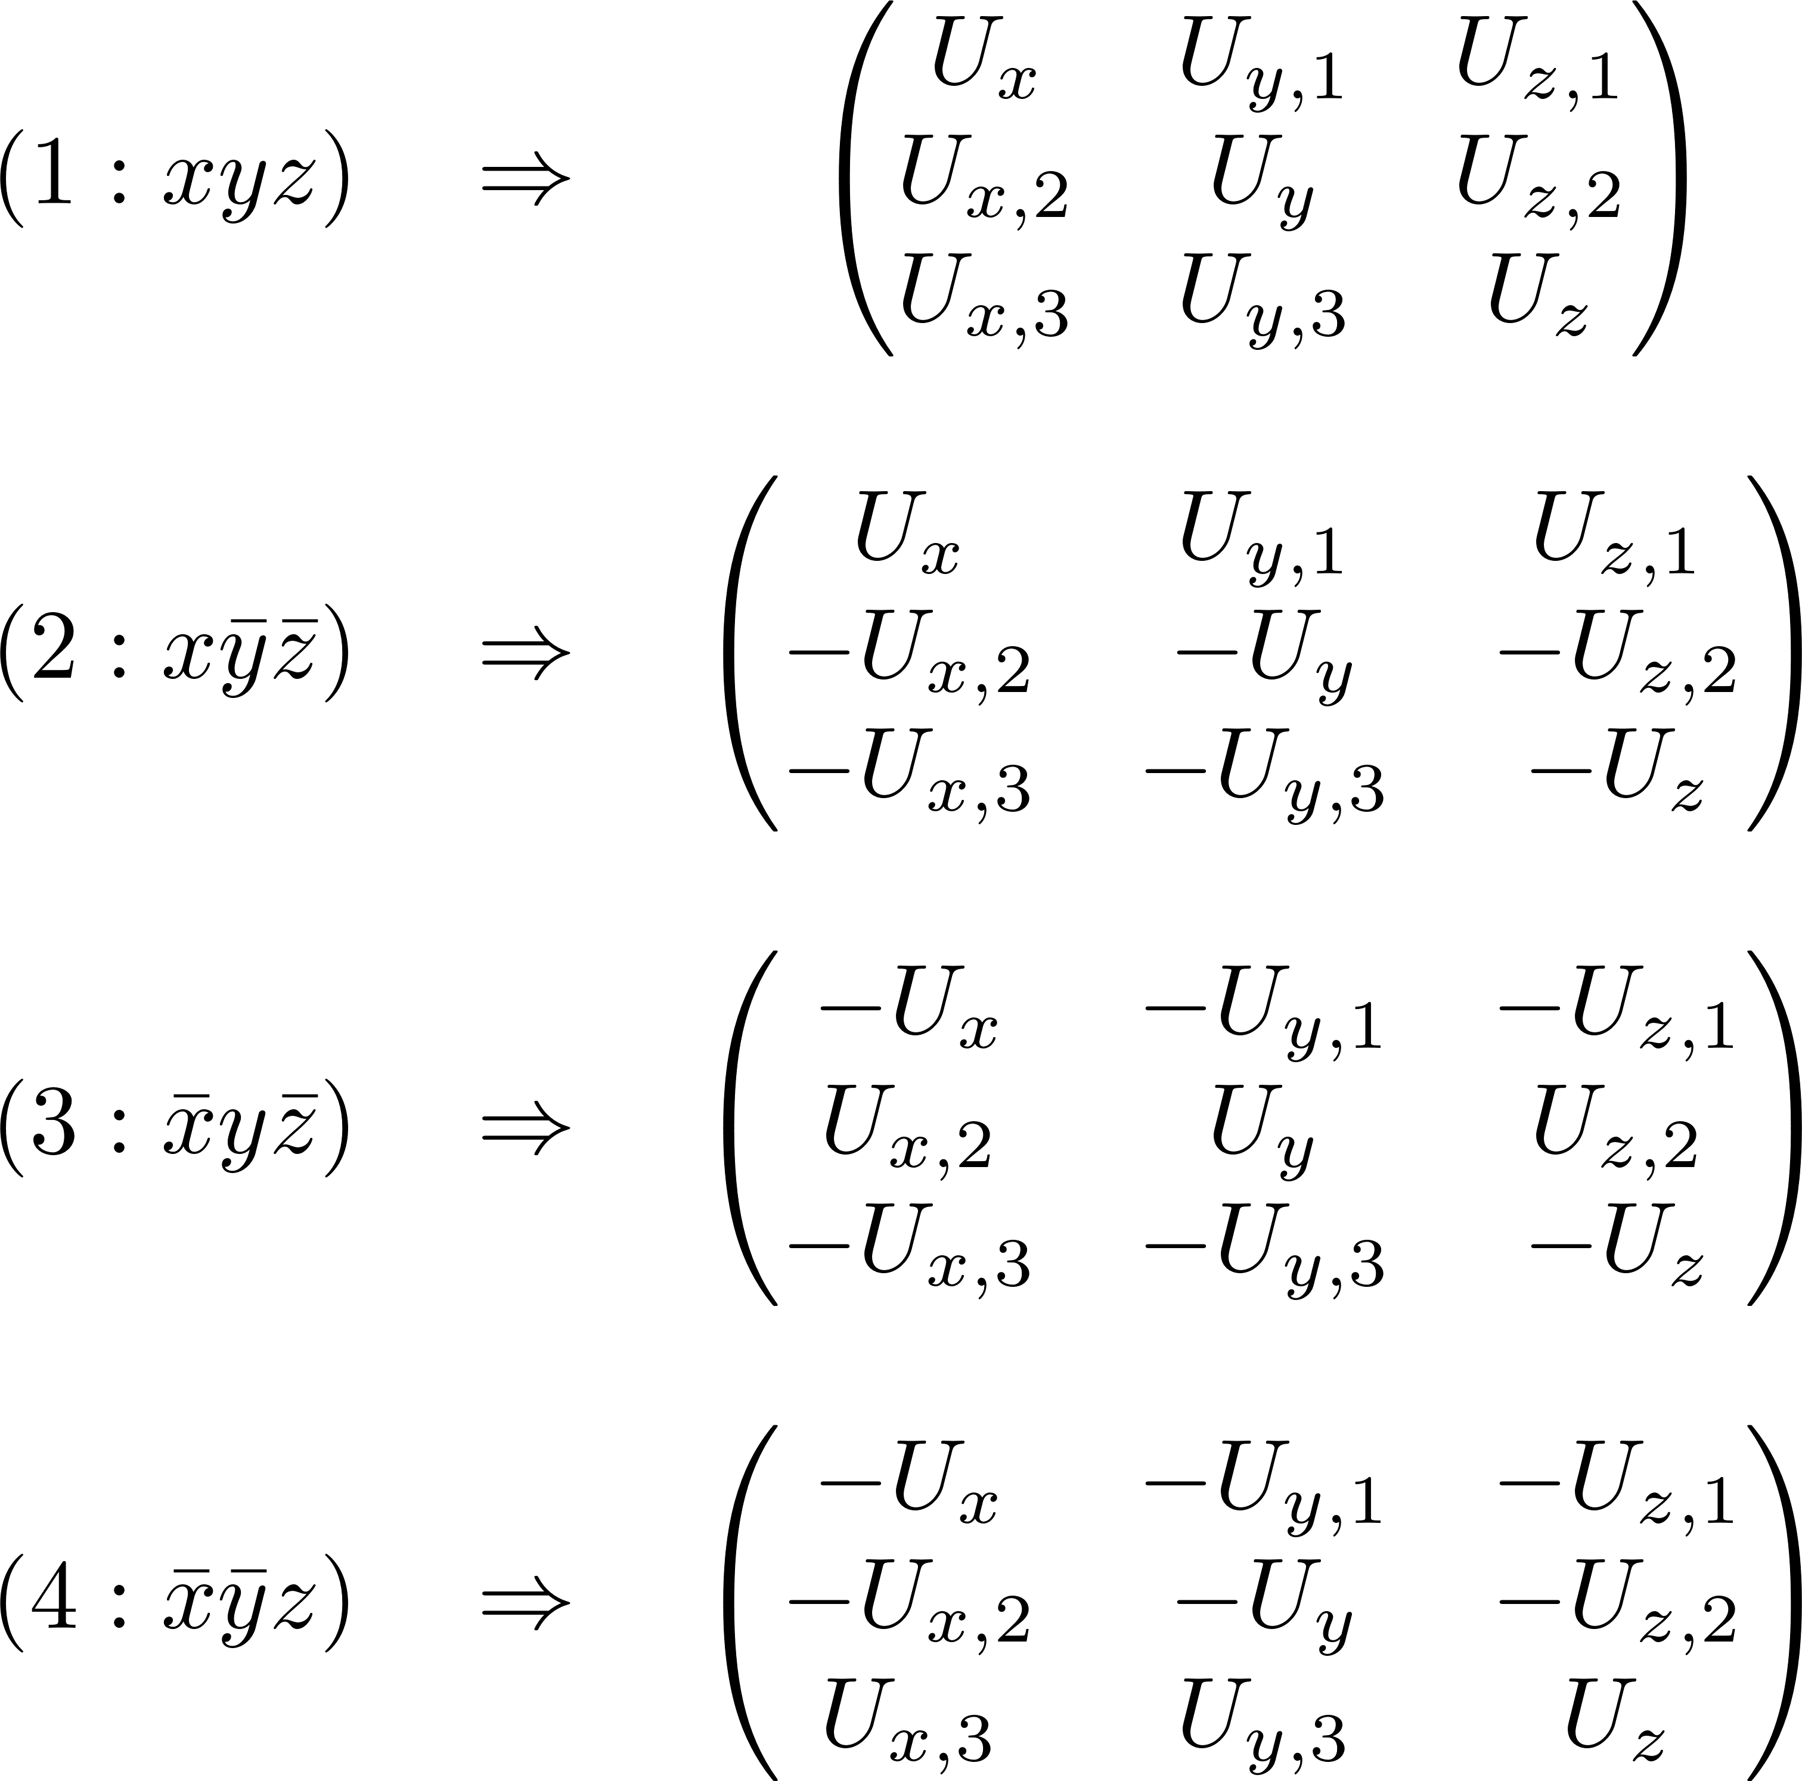
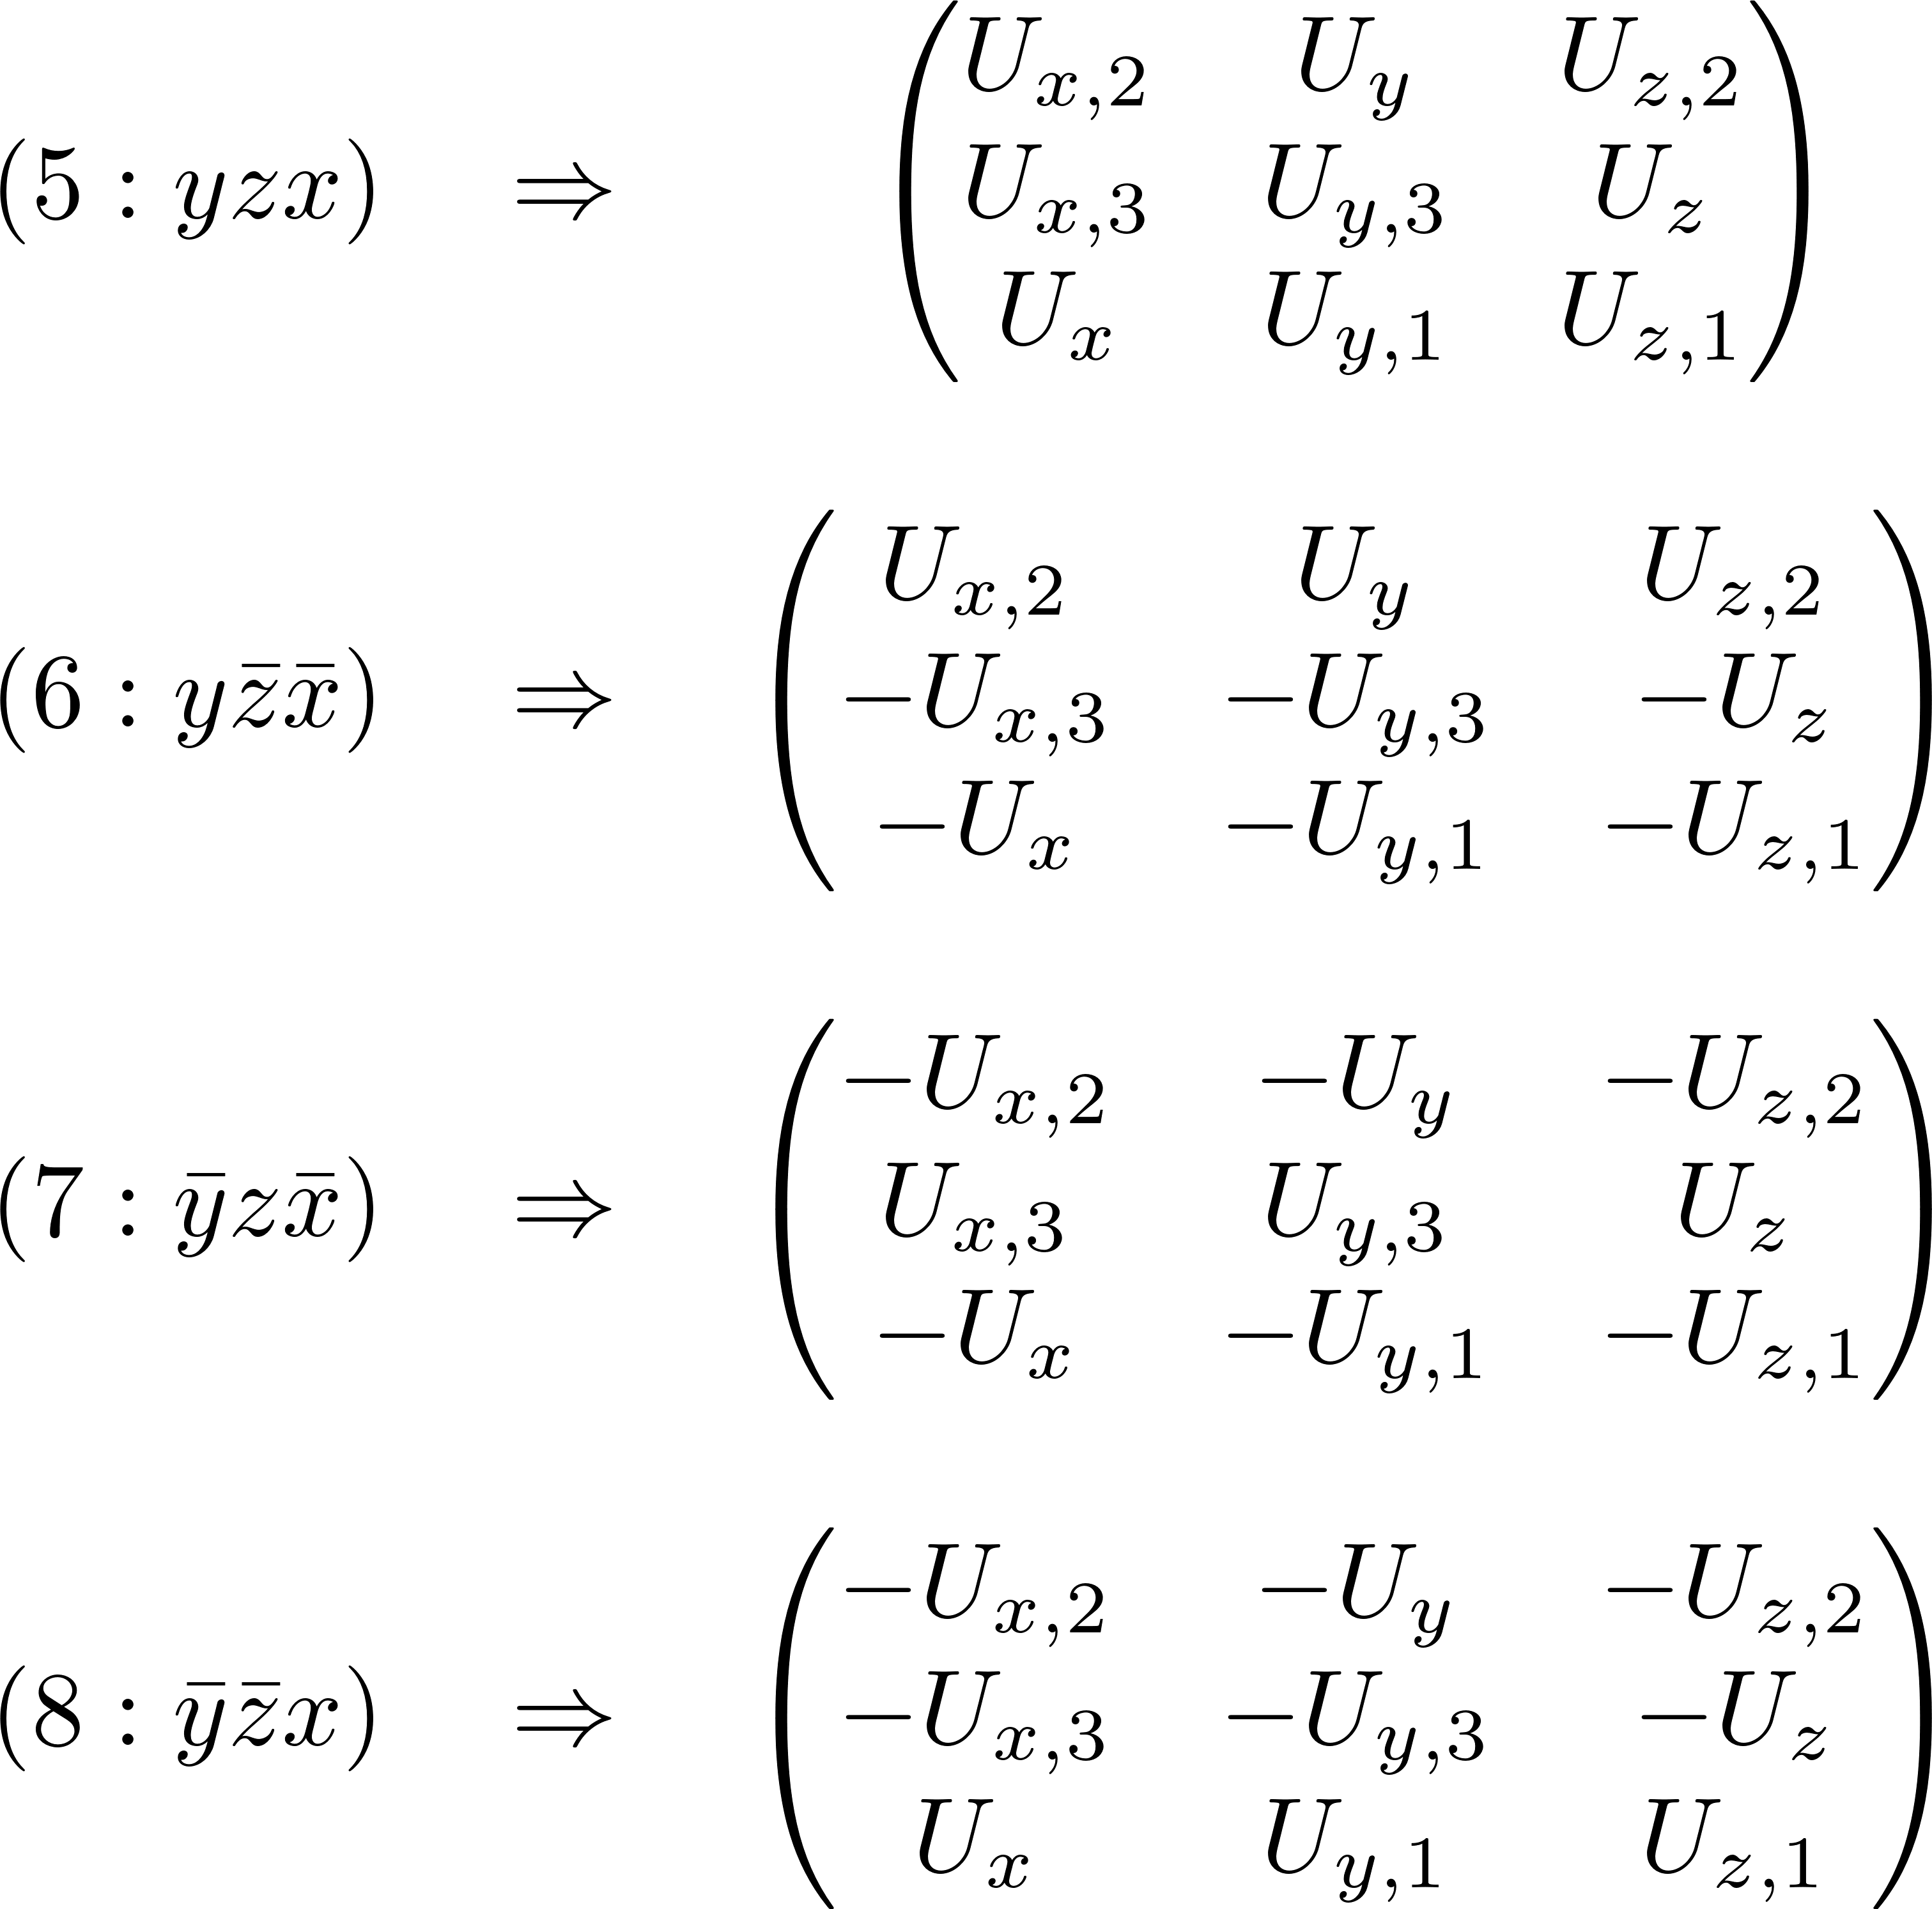
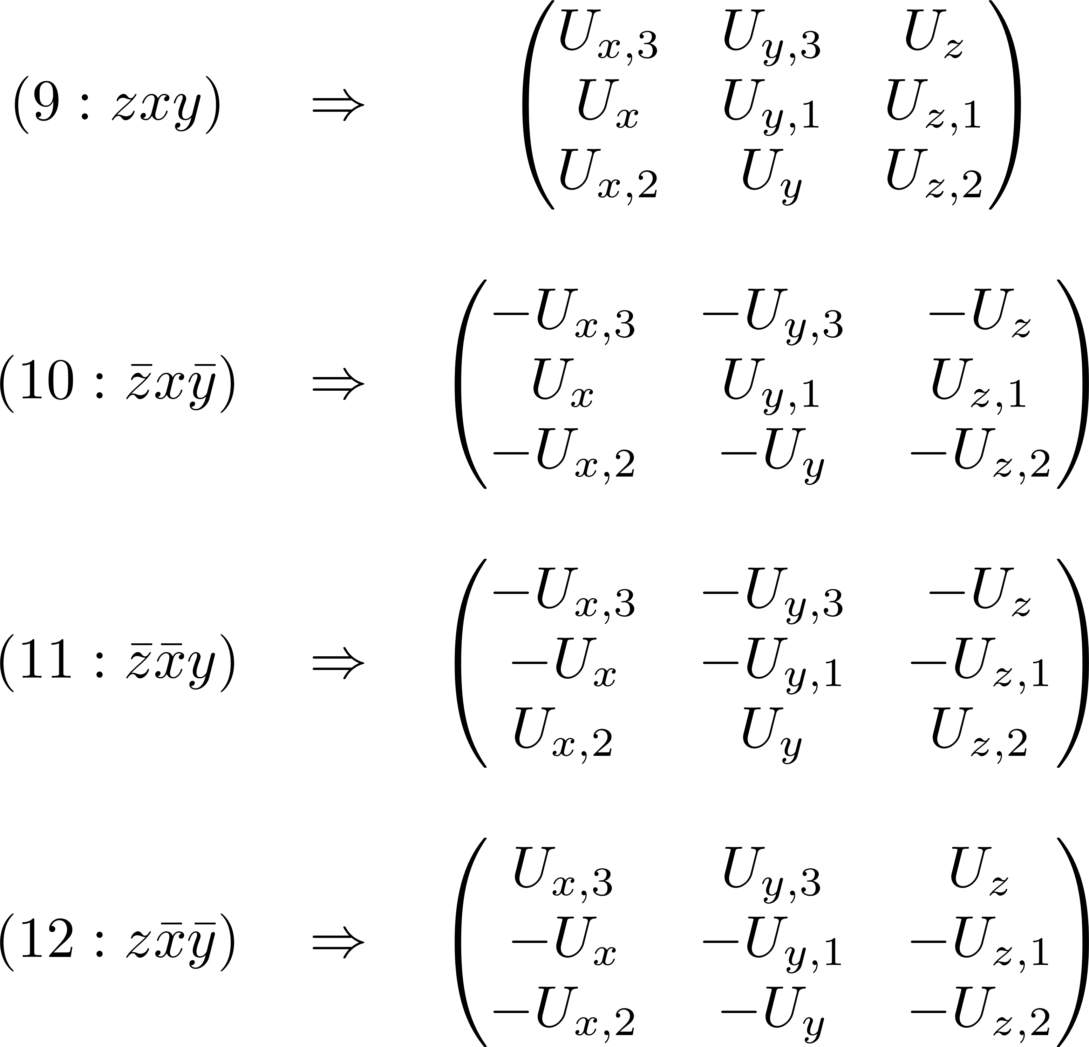
Matrix representation of T_{d} – T^{(σ)}

Slide 20
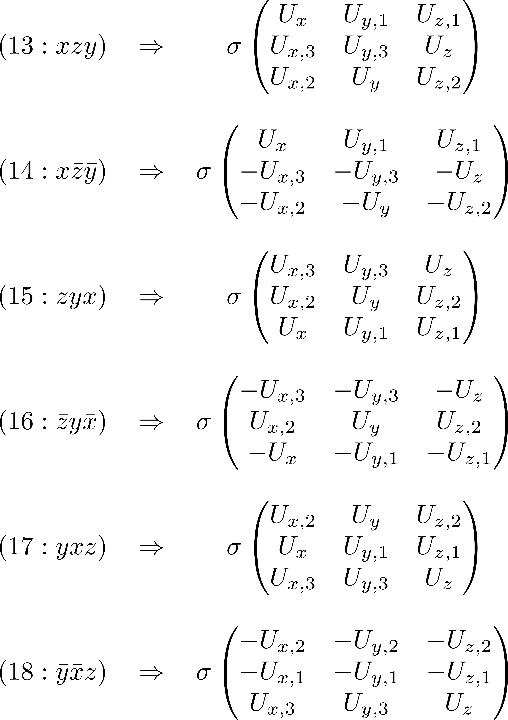
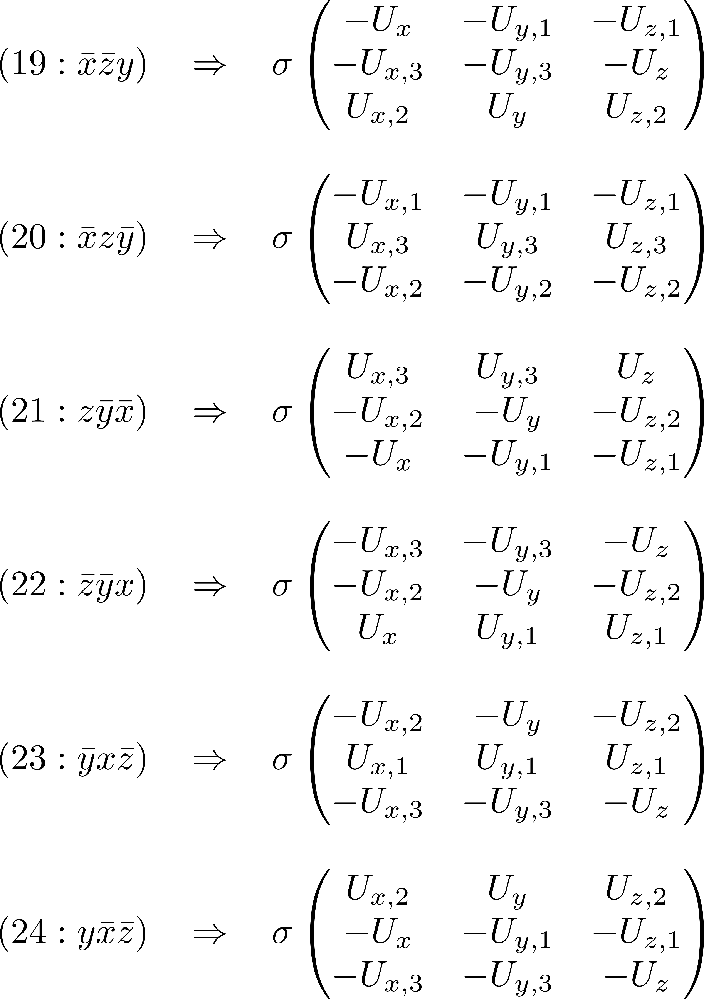
Matrix representation of T_{d} – T^{(σ)}

